Slide 1
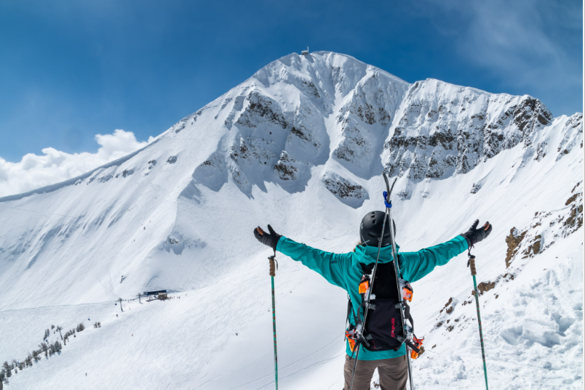
Big Mountain Resort
Grace

Slide 2
Problem Identification
What opportunities exist for Big Mountain Resort to effectively develop and implement a new pricing strategy that can maximize capitalization in their facilities investments to offset their recent additional operating cost by $1,540,000 this season.

Slide 3
Recommendation and key findings
Our Model suggests that Mountain Resort’s ticket price is lower than the predicted model by 16.31%, and the resort have many potential scenarios for either cutting costs by closing runs or increasing ticket price by increasing vertical drop, adding acres snow making or increasing the longest run.
Increasing the vertical drop by 150 ft would increase the ticket price by 10.44% from $81 to $89.46, resulting in revenue increase by $14,811,594.
Adding 2 acres of snow making would increase the ticket price by 12% from $81 to $90.75, resulting in revenue increase by $17,068,841.

Slide 4
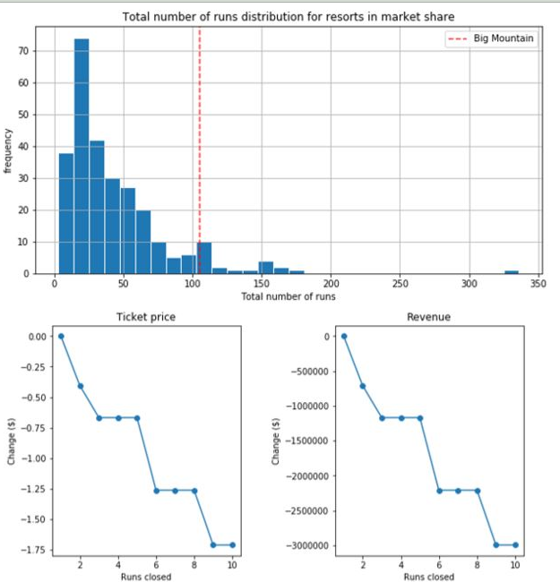

Slide 5
Modeling results and analysis
Big Mountain Resort has been reviewing potential scenarios for either cutting costs or increasing revenue (from ticket prices). Ticket price is not determined by any set of parameters; the resort is free to set whatever price it likes. However, the resort operates within a market where people pay more for certain facilities, and less for others. Being able to sense how facilities support a given ticket price is valuable business intelligence. This is where the utility of our model comes in.

Slide 6
Modeling results and analysis
Permanently closing down up to 10 of the least used runs. This doesn't impact any other resort statistics.
Increase the vertical drop by adding a run to a point 150 feet lower down but requiring the installation of an additional chair lift to bring skiers back up, without additional snow making coverage
Same as number 2, but adding 2 acres of snow making cover
Increase the longest run by 0.2 mile to boast 3.5 miles length, requiring an additional snow making coverage of 4 acres

Slide 7
Summary and conclusion
The best scenario where we managed to gain the highest revenue increase possible was by increasing the vertical drop by 150 ft, adding one Chair Lift, adding one run and adding 2 acres of snow making cover. This scenario has increased ticket price by 12% from $81 to $90.75, resulting in a bottom-line increase by $15,528,841 (After deducting operating costs = $1.54M).
Due to lack of data in regards of operating cost per used run and weekdays ticket price, our model cannot recommend closing down used runs or implementing a dynamic ticket pricing.

Slide 8
